Slide 1
Visual Analytics Assignment
Anshuman Dash

Slide 2
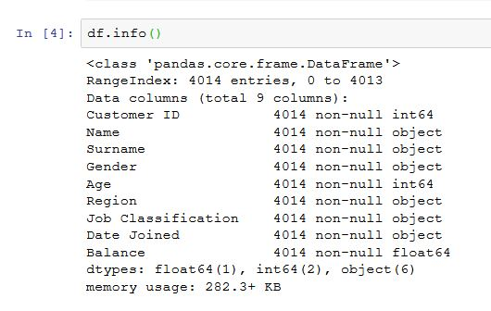
Objective :
Explore the data in Assignment_Bank-Customers-Data.csv
Find key insights in the data using visualisations learnt in the class
Business Objective of Bank: How to increase the revenue and reduce the cost
Data Exploration:
Created DataFrame DF and explored. DF.Info()
shows there are no non-null values
Dropping Customer ID, Name ,
Surname and Date Joined from the
Data set as they contain multiple
Factor levels.

Slide 3
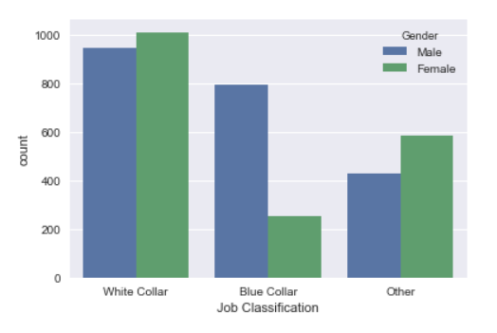
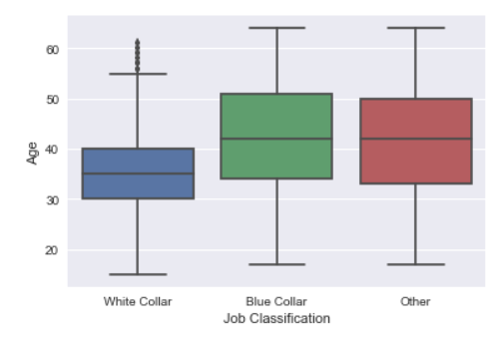
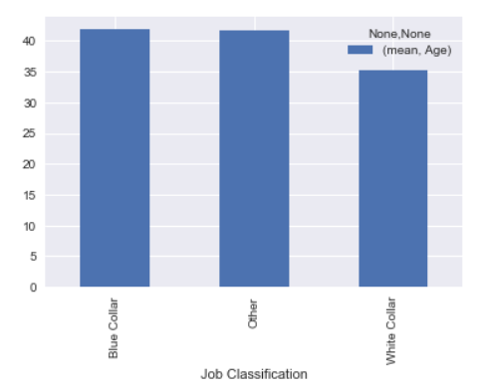
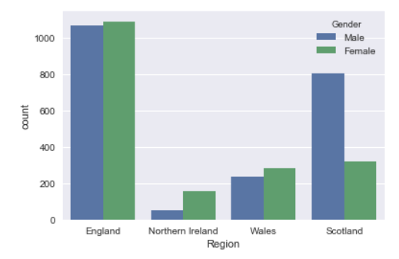
Data Exploration
Gender & Region v/s Job Class
More females are doing White Collar jobs than males
More females are doing other category jobs than males
More males are doing Blue Collared jobs
Highest no of jobs in England are done by females
More males are working in Scotland than females
More females are working in Northern Ireland than males
More younger people are doing white color jobs
Average age of people doing white color job is 35 years, while average age of people doing blue color job is 42 years

Slide 4
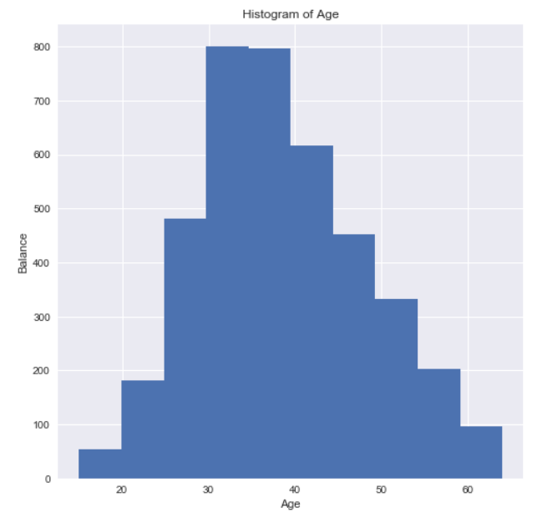
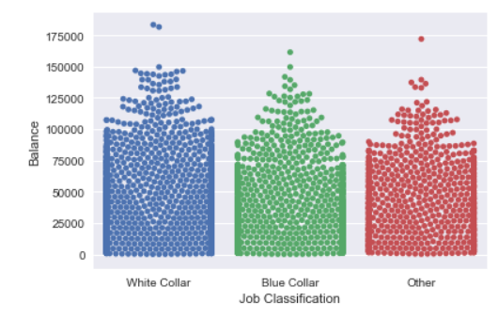
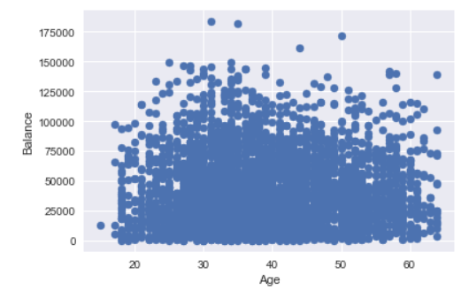
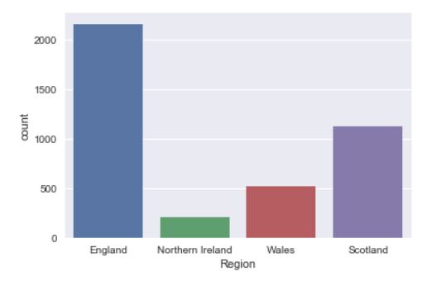
Data Exploration
Bank Account & Balance Analysis
People from England region hold maximum number of accounts in the bank
People with age range 30-35 are saving more money and thus they have higher bank balance compared to other age groups
It’s also clear when their age increases, they are saving less probably due to increased expenditure possibly due to family obligations
Young people doing white color jobs are able to save maximum due to which they have highest bank balance
People from all age groups have accounts in the bank

Slide 5
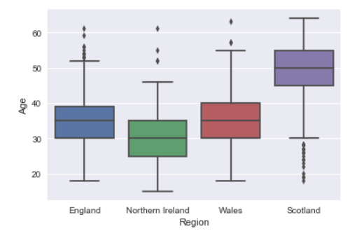
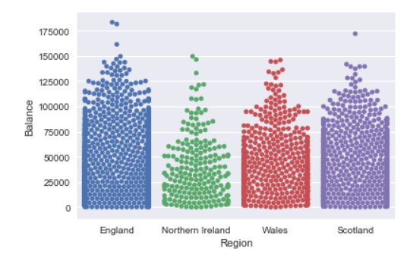
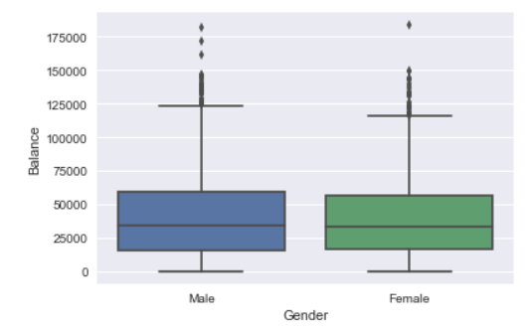
Data Exploration
People holding account from England have the highest amount of balance in their accounts
Account holders from Scotland have the highest median age of 50 years
There are certain male account holders having very high account balance, even though the median account balance between male and female customers are similar

Slide 6
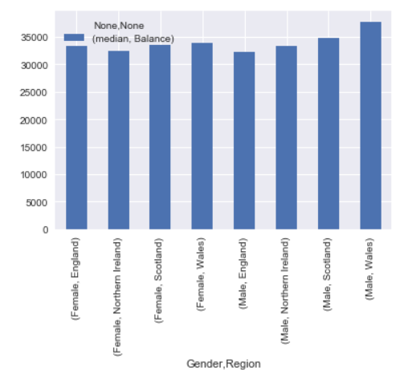
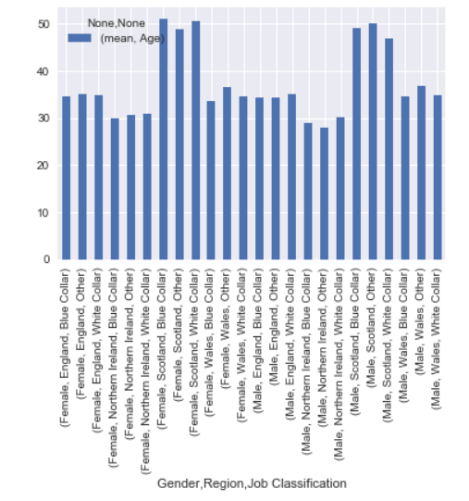
Data Analysis and Recommendation
Wales in spite of less population have the maximum average balance, followed by Northern Ireland, Scotland and England.
Comparatively Northern Ireland have younger people followed by England, Wales and Scotland.
To increase the revenue, bank should do email campaigning to the people of Wales and Northern Ireland and pursue them to increase the deposit amount.

Slide 7
Python Codes

Slide 8
Thank You

